Slide 1

Microservices Architecture
2023188 Faiq Abdullah
2023241 Hassan Iqbal
2023763 Yawar Qamal

Slide 2
5 Key Topics
1. Context
2. What is Microservices Architecture
3. Why and When should we use Microservices
4. Where is this architecture used (real-world examples)
5. What are the Pros and Cons of using this architecture

Slide 3
1. Context
What is software architecture
Why we need good system architecture
What is the Monolith architecture

Slide 4
1.1 What is Software Architecture
Software Architecture is the fundamental organization of a system; it's the blueprint that defines the system's structure, behaviour, and key properties. It encompasses the set of significant decisions about the organization of a software system.

Slide 5
1.2 Why do we need good Software Architecture
Scalability
Maintainability
Flexibility
Performance
Security
Reliability
Cost and Risk minimization
And so on…

Slide 6
1.3 What is the Monolith Architecture
The Monolith Architecture (or Monolithic Architecture) is a traditional software architecture where all functional components of an application—such as the user interface, business logic, and data access layer—are tightly coupled into a single, indivisible codebase and deployed as a single unit.

Slide 7
Problems with Monolith that create a need for a new type of architecture
1. Scaling Inefficiency (All-or-Nothing Scaling)
2. Slow Development Velocity and Deployment Risk
3. Single Point of Failure

Slide 8
2. What is Microservices Architecture
1. Describing Microservices Architecture
2. Key features of Microservices architecture

Slide 9
2.1 Describing Microservices Architecture
Microservice Architecture is an architectural style that structures an application as a collection of small, independent, and loosely coupled services that communicate with each other, usually over a network via lightweight protocols (like HTTP/REST or asynchronous messaging).
It is a deliberate counterpoint to the Monolithic Architecture, designed to solve the scaling, complexity, and agility problems that arise in large, integrated applications.

Slide 10
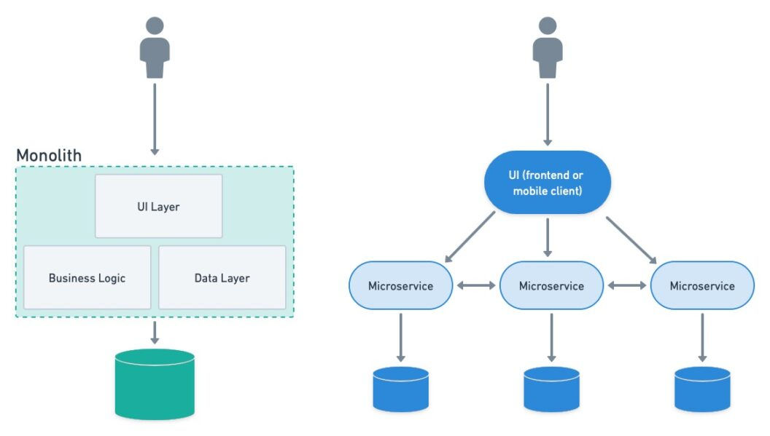

Slide 11
2.2 Key Features
1. Small and Autonomous Services
2. Dump Pipes and Smart Endpoints
3. Decentralized Data Management
4. Independent Deployment
5. Multiple Technological Implementations
6. Lightweight Communication between services
7. Organizational Alignment: Conway's Law

Slide 12

3.1 Where to use Microservices
Complex and Evolving Applications
High Traffic Platforms with Variable Loads
Systems Requiring High Availability
Organizations with multiple teams

Slide 13
3.2 Why is it useful
3.2.1 Business Utility
Faster Time to Market (deploy small services immediately)
Cost Optimization (scale services that generate revenue)
Risk Reduction (badly deployed service doesn’t affect other ones)
3.2.2 Developer Utility
Technology Freedom (Use different Technologies)
Cognitive Load (Small code for each service compared to monolith)
Faster Debugging and Testing for a service

Slide 14

3.2 Why is it useful
3.2.3 Software Utility
Fault Isolation
Scalability

Slide 15
4. Examples

Slide 16
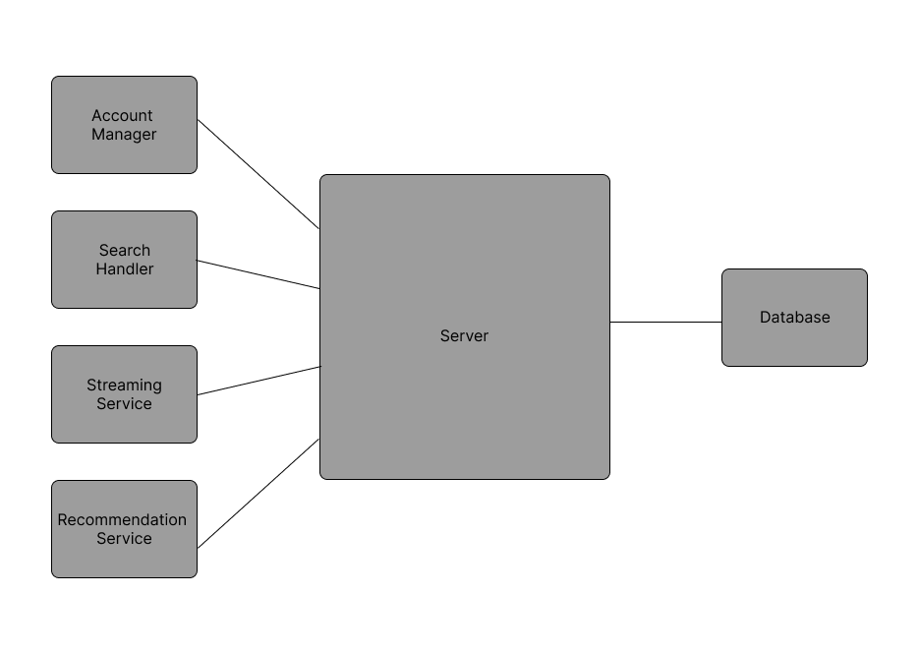
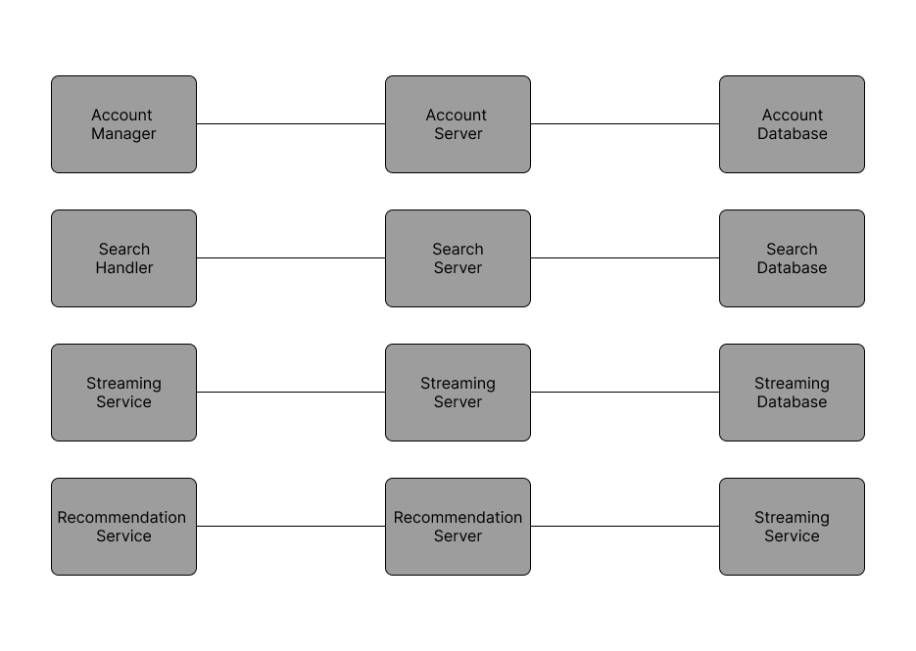
4.1 General Comparative Example

Slide 17

4.2.1 Real World Example 1: Netflix
Let’s say you press the play button on Netflix, these are the microservices that run in the background
Authorization Service (Checks Subscription)
Recommendation Service (Updates the “Because you watched’’ list)
Content Delivery Service (Locates the nearest server with the video)
Device Service (Formats and Plays the video)

Slide 18
4.2.1 Netflix Example Cont.
Resilience Example: If the Recommendation Service crashes, Netflix doesn't show an error page. Instead, the system falls back to a "Default" generic list of popular movies. The user never knows something broke.

Slide 19

4.2.2 Real World Example 2: Uber
Their Microservices Include:
Passenger Management Service
Driver Management Service
Trip Management Service
Billing Service
Resilience Example: If the Billing Service has a latency spike or goes down, the ride continues and processes the payment later. The core service is decoupled from the supporting service (payment).

Slide 20
5. Pros and Cons

Slide 21
5.1 Pros of Microservices Architecture
Modular Scalability
Fault Isolation
Independent Deployment
Technology Freedom

Slide 22



Slide 23
5.2 Cons of Microservices Architecture
Distributed System Complexity
Data Consistency Issues
Operational Overhead
Harder Testing of the system as a whole
Higher Initial Cost

Slide 24
6. BONUS SECTION! Summary

Slide 25
Core Concept of Microservice Architecture: Decomposition of services to create a loosely coupled system, where each service has a single responsibility.
How it works: It works using Independent Deployment, Decentralized Data and Loose coupling
Best use case: Large, complex systems where monolithic architecture causes bottlenecks
Pros: Granular Scalability, tech freedom and fault isolation
Cons: Operation Complexity (DevOps), Network Latency, Data Consistency

Slide 26
Presentation Over. Thank you!

